Slide 1
Phishing Attack Incident in Real Time or Online Financial Scams
Presented By:
Vishnu Priya K 2021115121 IT- College of Engineering Guindy, Anna University.

Slide 2
OUTLINE
Problem Statement
Proposed System/Solution
System Development Approach (Technology Used)
Algorithm & Deployment
Result (Output Image)
Conclusion
Future Scope
References

Slide 3
Problem Statement
Phishing attacks are a pervasive threat in the digital age, targeting individuals and organizations alike. These deceptive attempts trick victims into revealing confidential information, such as login credentials, financial details, or personal data. Phishing emails often impersonate legitimate sources like banks, credit card companies, or trusted institutions, creating a sense of urgency or fear to pressure recipients into clicking malicious links or downloading malware.
The success of a phishing attack can have devastating consequences. Organizations can suffer data breaches, financial losses, and reputational damage. Individuals may face identity theft, financial fraud, and emotional distress.

Slide 4
Proposed Solution
The proposed system aims to mitigate the risks associated with phishing attacks by employing a multi-layered approach that combines technical security measures and employee training programs.
Components:
Technical Measures:
Implement robust email filtering systems with machine learning capabilities to identify and quarantine suspicious emails based on sender address, language patterns, and known phishing tactics.
Utilize firewalls and intrusion detection systems (IDS/IPS) to continuously monitor network traffic for malicious activity and unauthorized access attempts.
Enforce strong password policies and multi-factor authentication (MFA) to add an extra layer of security beyond passwords.
Employ regular software and system updates with the latest security patches to address vulnerabilities exploited by phishing attempts.
Employee Training Programs:
Develop and deliver educational programs to equip employees with the knowledge to identify phishing tactics, recognize common red flags, and understand safe practices for handling emails and online interactions.
Conduct simulated phishing attacks to test employee awareness and identify areas for improvement. This allows for targeted training based on employee responses.
Foster a culture of cybersecurity awareness by encouraging open communication regarding suspicious activity and promoting responsible reporting procedures.
Expected Outcome:
This system strives to achieve a significant reduction in the risk of successful phishing attacks within the organization. The effectiveness can be measured through:
Reduced Phishing Emails Reaching Users: Email filtering systems should significantly decrease the number of phishing emails reaching employee inboxes.
Increased Employee Awareness: Training programs should lead to a measurable increase in employee awareness of phishing tactics, allowing them to identify and report suspicious emails.
Reduced Data Breaches: The combined efforts aim to minimize the chances of employees falling victim to phishing attempts, ultimately reducing the risk of data breaches.
While a complete elimination of phishing threats is unlikely due to their evolving nature, this system aims to create a robust defense and a culture of cybersecurity awareness within the organization.

Slide 5
System Approach
This system would leverage a combination of existing technologies and ongoing employee education.
Email Filtering Technologies: Advanced spam filters with machine learning capabilities can identify suspicious emails based on sender address, language patterns, and known phishing tactics.
Security Software and Firewalls: Antivirus software, intrusion detection/prevention systems (IDS/IPS), and firewalls would form a layered defense against malware and unauthorized network access.
Authentication Tools: Implementing multi-factor authentication (MFA) adds an extra layer of security beyond passwords by requiring a second verification factor, like a code sent via text message or a fingerprint scan.
Learning Management Systems (LMS): Online platforms can deliver interactive training modules on phishing awareness, best practices, and reporting procedures.

Slide 6
Algorithm & Deployment
Algorithm Selection: Supervised Learning with Classification Algorithms: This approach is well-suited for identifying phishing emails based on historical data. We can train a model to classify emails as legitimate or phishing attempts. Popular choices include:
Support Vector Machines (SVM): Efficiently handles high-dimensional data (emails with various features) and offers good performance in phishing detection.
Random Forest: Robust against overfitting and effective in handling imbalanced datasets (where phishing emails might be a smaller portion).
Data Input: The model will be trained on a dataset containing features extracted from emails, including: Email Headers: Sender address, recipient address, subject line, message origin (IP address). Email Body: Content analysis for keywords commonly used in phishing attempts, urgency or fear triggers, and inconsistencies (e.g., mismatched sender and message content). Sender Reputation: Historical data on known phishing senders or blacklisted domains. Attachment Analysis: File types, presence of malicious code indicators.
Training Process: Data Preprocessing: Clean and prepare the data by handling missing values, removing outliers, and feature engineering (e.g., converting categorical data to numerical). Model Training: Split the data into training and testing sets. Train the chosen algorithm (e.g., SVM or Random Forest) on the training set, allowing it to learn the patterns that differentiate legitimate emails from phishing attempts. Hyperparameter Tuning: Optimize the model's performance by adjusting hyperparameters (internal settings) that influence its behavior. Techniques like cross-validation can be used to evaluate different configurations and select the optimal settings. Model Evaluation: Assess the trained model's performance on the testing set using metrics like accuracy, precision, and recall. Analyze how well the model identifies phishing emails and minimizes false positives (flagging legitimate emails as phishing).
Deployment: Integration with Email Server: Integrate the trained model with the organization's email server to analyze incoming emails in real-time. Email Classification: The model analyzes each email's features and classifies it as legitimate or phishing. Actionable Outcomes: Legitimate emails are delivered to users' inboxes. Phishing emails are quarantined or flagged for further review to prevent user interaction.
Continuous Improvement: Regularly retrain the model with new phishing email data to maintain effectiveness against evolving tactics. Monitor the system's performance and adapt based on real-world results. This approach leverages machine learning to automate email filtering and improve threat detection accuracy. By continuously learning and adapting, the system can become a powerful tool in the fight against phishing attacks.

Slide 7
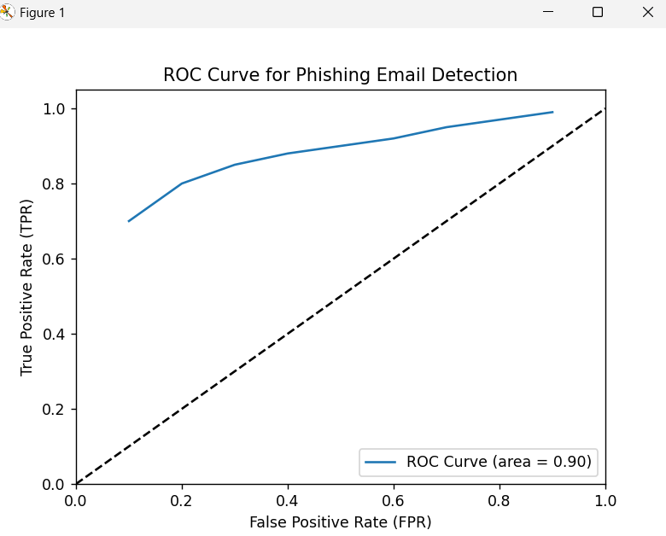
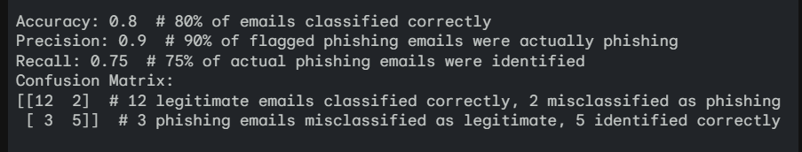
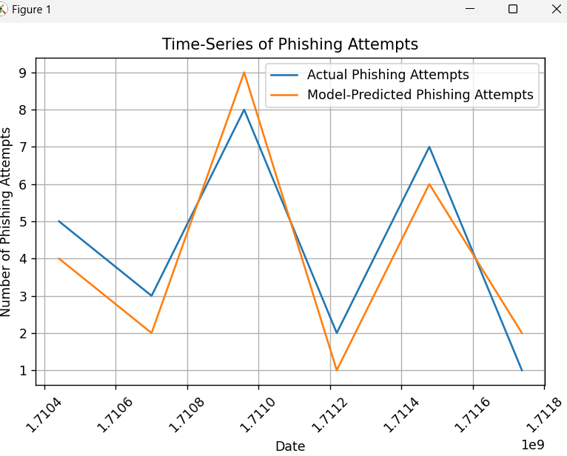
Result
Confusion Matrix ROC Curve Time-Series Graph

Slide 8
Conclusion
By implementing a combination of technical security measures and employee training programs, organizations can significantly bolster their defenses against phishing attacks. Building awareness, fostering a culture of security, and staying up-to-date with evolving tactics are crucial for protecting sensitive information in today's digital landscape.

Slide 9
Future scope
Ongoing vigilance and adaptation are critical in the fight against phishing.
Continuously update technical solutions and training programs to address new phishing tactics.
Integrate security awareness into company culture, promoting proactive reporting of suspicious activity.
Explore advanced threat intelligence techniques to stay ahead of emerging phishing trends.

Slide 10
References
Anti-Phishing Working Group (https://apwg.org/reportphishing/)
National Institute of Standards and Technology (NIST) Special Publication 800-69

Slide 11
THANK YOU

